Slide 1

JULY 2018
MSBA - STATISTICS
GROUP 2
IBM HR – EMPLOYEE ATTRITION
Vincent Kuo
Clay Mason
Stella Sun
Kimmy Zhuo
Candice Zuo

Slide 2
Contents
Project Overview
Data Dictionary
Exploratory Analysis
Models and Findings
Summary

Slide 3
IBM HR Data Project Overview
Objective: Create a model that accurately predicts which employees will leave the company
Source: IBM Data Science Team Kaggle.com - HR Analytics
Data | Count | Note
Observations | 1,470
# of Variables | 35
# of Variables Removed | 4 | 1. Employee Count, 2. Employee Number | 3. Standard Hours, 4. Over 18
# of Variables with Null Values | 0
# of Variables with Numeric Values | 23 | 8 are ratings on a scale (e.g. 1=low, 4= high)
# character columns converted to factors | 8 | Attrition Business Travel Department Education Field | 5. Gender 6. Job Role 7. Marital Status 8. Overtime Status
Notes:
Data Source – IBM Data Science team
https://www.kaggle.com/pavansubhasht/ibm-hr-analytics-attrition-dataset/home
Initial Reasons for Selecting Data
“Business” type problem & No HR focused class in the MSBA program.
IBM recruits heavily in Austin and the data set is decently popular on the internet.
Fewer observations, so could do sanity checks with Excel while we continue to build our skillset in R
Readily available data on Kaggle and designed for a data science project
Some errors in salary data - the salary rates (hourly, daily, and monthly) do not tie and similarly the Monthly Income field cannot be tied tied to the rate fields even though employees are assumed to have the same amount of working hours. Comparing individual employees to each other leads to inexplicable differences between these fields even while controlling for overtime eligible employees.
Fabricated/altered data changes your perception or angle of attack when looking at data. For example, you’re less inclined to compare data findings to industry benchmarks, and it also numbs your skepticism on the findings of your analysis knowing somebody purposefully changed the data. For example, most employees averaged about a 15% raise (high average is not due to outliers).
The project did not have much data cleaning, which is abnormal for a typical data science project. However, it allowed us to focus on the statistical methods taught during class, as opposed to focusing on learning R to just clean the data.
Variable Removal – same value for each row or non-identifying information
1. Employee Count, (All = 1)
2. Employee Number (numbering for rows/unique employees) If this data was not altered and a true real world example, you could argue that there may be some significance to this field if employees who previously left the firm, but came back to the firm were given their old ID. Another example, would be an Analyst class that all joined at the same time with similar employee numbers, and they exhibited some staying power (or the opposite) due to other attributes not captured by one of the variables in the data set.
3. Standard Hours (All = 80)
4. Over 18 (the entire sample was over 18)

Slide 4
Data Dictionary
Variable | Type | Note
Attrition | String | Yes or No
Business Travel | String | Non_Travel Travel_Rarely Travel_Frequently
Department | String | HR R&D Sales
Education Field | String | Human Resources Life Sciences Marketing Medical Other Technical Degree
Gender | String | Male Female
Variable | Type | Note
Job Role | String | Healthcare Rep. Human Resources Laboratory Tech. Manager Manufacturing Dir Research Dir Research Scientist Sales Executive Sales Rep
Marital Status | String | Single Married Divorced
Overtime Status | String | Yes or No
Education | Integer - Scale | 1 (Below College) 2 (College) 3 (Bachelors) 4 (Masters) 5 (Doctorate)
Notes:
Our target variable is employee attrition. We are exploring models that predict whether an employee will leave or not based on 34 other variables.
The variables are broadly categorized into two categories and two sub categories
Business
Objective
Attrition - Target Variable
Business Travel
Department
Job Role
Overtime Status
Stock Option Level
Daily Income Rate
Hourly Rate
Monthly Income
Monthly Rate
Percent Salary Hike
Training Time Last Year
Subjective
Environment Satisfaction
Job Satisfaction
Job Involvement
Performance Rating – Only 3s and 4s were given to employees (sample bias? or maybe constructive feedback is an area for improvement)
Relationship Satisfaction
Work Life Balance
Relationship Satisfaction
Demographic / Work Background
Personal
Education Field
Gender
Marital Status
Education Level
Age
Distance from Home
Work Background
Number of companies worked
Total Working Years
Years at Company
Years in Current Role
Years Since Last Promotion
Years with Current Manager

Slide 5
Data Dictionary
Variable | Type | Note
Environment Satisfaction | Integer – Scale | 1(low) – 4 (high)
Job Satisfaction | Integer – Scale | 1(low) – 4 (high)
Job Involvement | Integer – Scale | 1(low) – 4 (high)
Job Level | Integer – Scale | 1(low) – 5 (high)
Performance Rating | Integer – Scale | 3(low) – 4 (high)
Relationship Satisfaction | Integer – Scale | 1(low) – 4 (high)
Stock Option Level | Integer – Scale | 0(low) – 3 (high)
Work Life Balance | Integer – Scale | 1(low) – 4 (high)
Age | Integer
Daily Rate | Integer
Distance From Home | Integer
Hourly Rate | Integer
Monthly Income | Integer
Monthly Rate | Integer
Num Companies Worked | Integer
Percent Salary Hike | Integer
Total Working Years | Integer
Training Times Last Year | Integer
Years At Company | Integer
Years In Current Role | Integer
Years Since Last Promotion | Integer
Years With Curr Manager | Integer
Variable | Type | Note
Employee Count | Integer | REMOVED
Employee Number | Integer | REMOVED
Over 18 | String | REMOVED
Standard Hours | Integer | REMOVED
Notes:
Variables marked as integers with scale are mainly subjective attributes. Stock Option Level and Education Level are the main to variables in this category that could be scrutinized as being an objective measure if certain assumptions are made. The data and data descriptions provided in this project do not let us make this interpretation however.
Data Issues for variables on this slide –
Performance rating is split between 3 and 4 (no 1s or 2s).
Income variables previously mentioned (3-4 variables that seemingly should tie to one another but do not). You can’t multiply hourly income rate times 8 to get the daily rate. Also some employees will have a higher daily rate, but lower hourly rate. Other odd combinations of this also existed with monthly rate and daily rate as well.
Subjective nature of some of the scaled attributes would make us pause about the data collection methods in the real word.

Slide 6
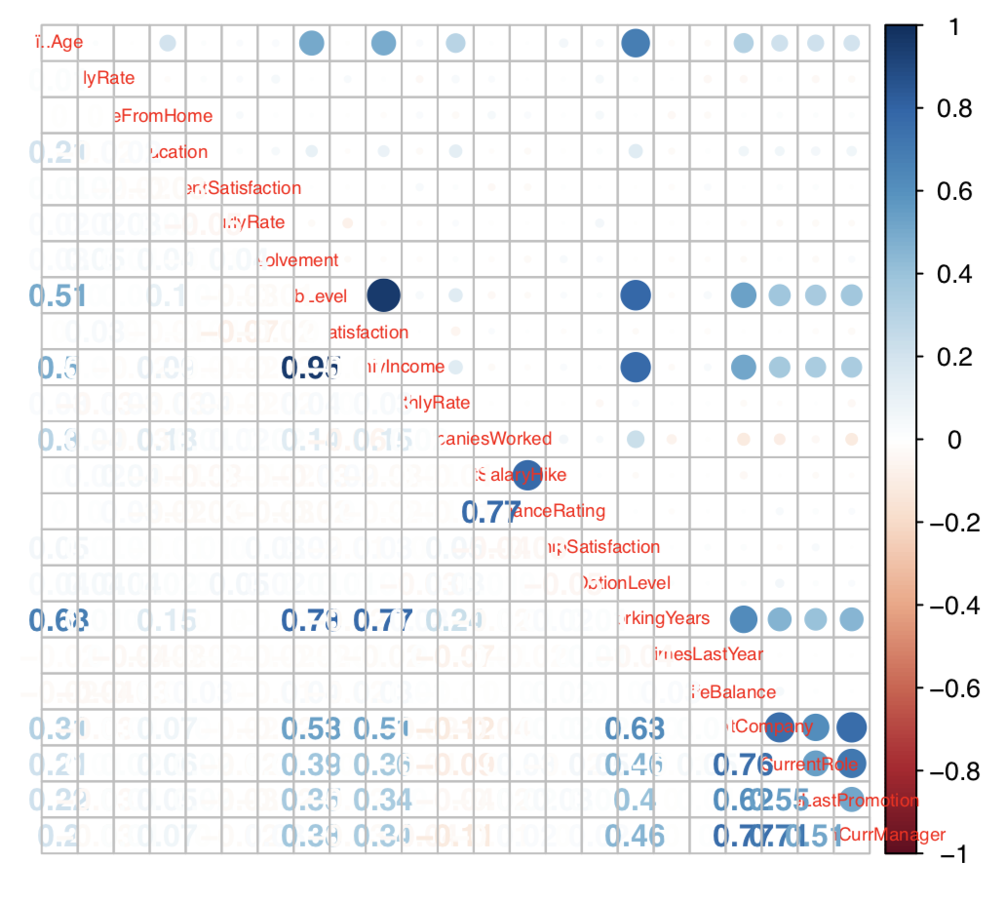
Exploratory Analysis – Correlation Matrix
Variable Relationship | Correlation
Monthly Income & Job Level | 95.0%
Total Working Years & Job Level | 78.2%
Total Working Years& Monthly Income | 77.3%
Performance Rating & Percent Salary Hike | 77.4%
Education & Total Working Years | 14.8%
Education & Num Companies Worked | 12.6%
Education & Percent Salary Hike | 9.5%
Work Life Balance & Age | -2.1%
Num Companies Worked & Job Satisfaction | -5.6%
Training Times Last Year & Over Time | -7.9%
Num Companies Worked & Years With Curr Manager | -11.0%
Num Companies Worked & Years At Company | -11.8%
Notes:
One of the first steps in our Exploratory Analysis was to run a regression of all of the numeric variables.
Most of the high and low correlations were not surprising. For example, variables that are both related to time are naturally going to have high correlations.
E.g. Years in current role and years with current manager
A few notable correlations are shown in the table to the left of the graph. Monthly income and job level had the highest correlation (95%) as one would expect. It typically takes a long time to reach higher job levels, so there is also a high correlation between total working years and both Monthly Income and Job Level.
Although performance rating was limited to just 3s and 4s, there is a positive correlation with employee salary increases. Better performing employees are reaping the benefits of their hard work with salary increases. You would think that employees who are getting raises would
have a high satisfaction with their colleagues. However, the most negatively correlated variable with salary hike is relationship satisfaction.
# check correlation among numerical variables
# JobLevel & MonthlyIncome: 0.95
# MonthlyIncome & Working Years: 0.77
# JobLevel & WorkingYears: 0.78
# PercentSalaryHike & Performance Rating: 0.77
# YearsatCompany & YearInCurrentRole: 0.76
# YearsatCompany & YearsCurrManager: 0.77
# YearInCurrentRole & YearsCurrManager: 0.71
# Age & WorkingYears: 0.68
# WorkingYears & YearsatCompany: 0.63
# YearsatCompany & YearssinceLastPromotion: 0.62

Slide 7
Exploratory Analysis – Population
Variable |  | % of Sample | No | Yes
Overall Sample |  | 100% | 84% | 16%
Business Travel | No Travel Rarely Travel Frequently | 10% 71% 19% | 92% 75% 85% | 8% 25% 15%
Department | Human Resources Research & Development Sales | 4% 65% 30% | 81% 86% 79% | 19% 14% 21%
Education Field | Human Resources Life Sciences Marketing Medical Other Technical Degree | 2% 41% 11% 32% 6% 9% | 74% 85% 78% 86% 87% 76% | 26% 15% 22% 14% 13% 2%
Gender | Female Male | 40% 60% | 85% 83% | 15% 17%
Job Role | Healthcare Representative Human Resources Laboratory Technician Manager Manufacturing Director Research Director Research Scientist Sales Executive Sales Representative | 9% 4% 18% 7% 10% 5% 20% 22% 6% | 93% 77% 76% 95% 93% 98% 84% 83% 60% | 7% 23% 24% 5% 7% 3% 16% 17% 40%

Slide 8
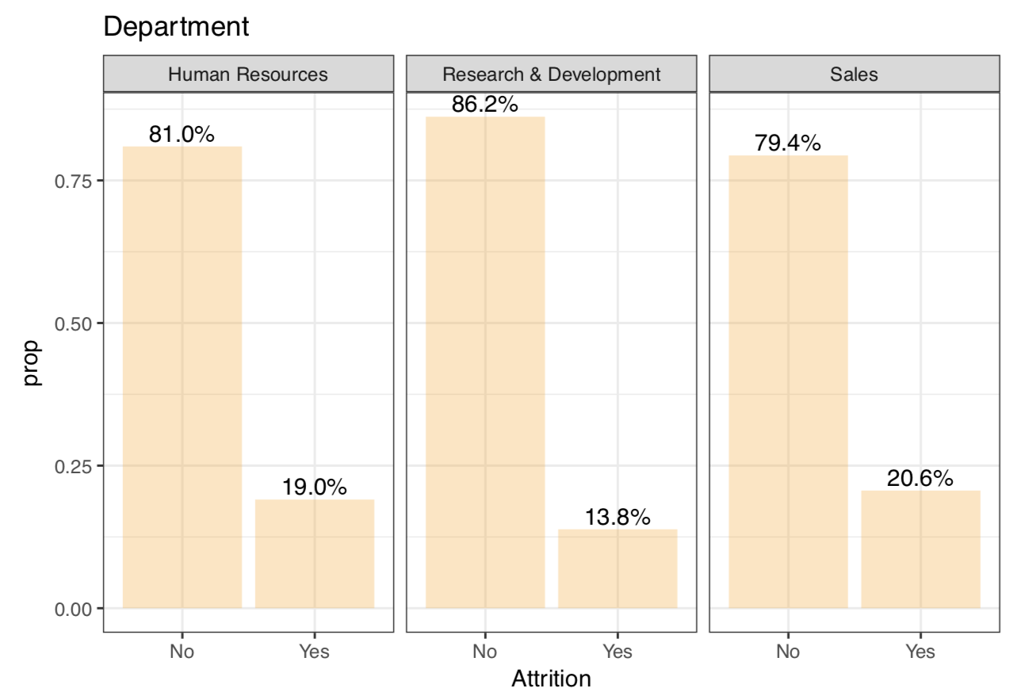
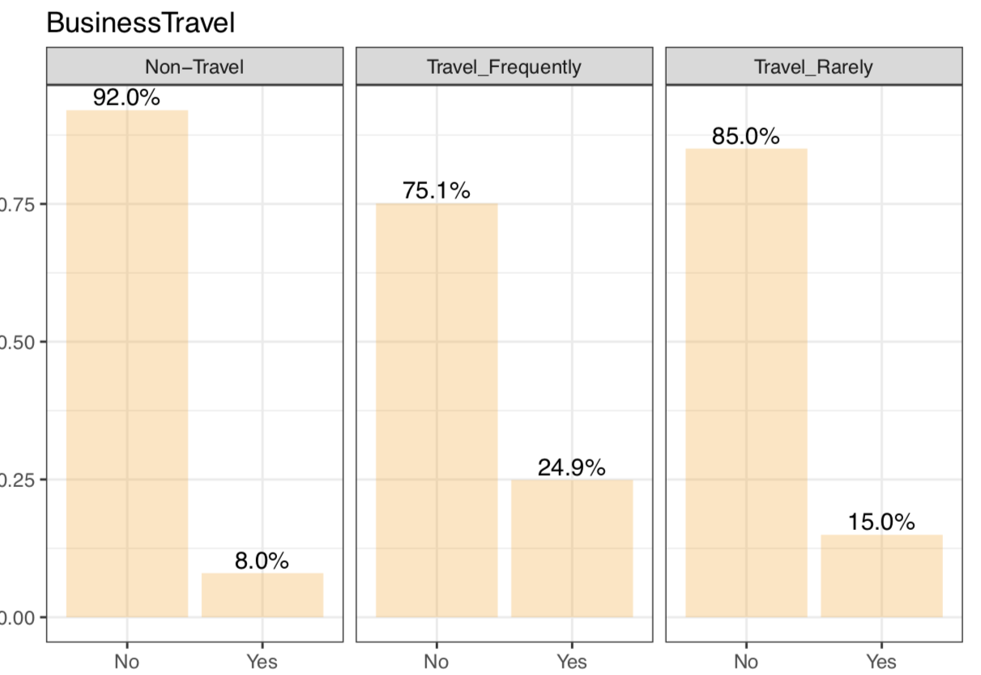
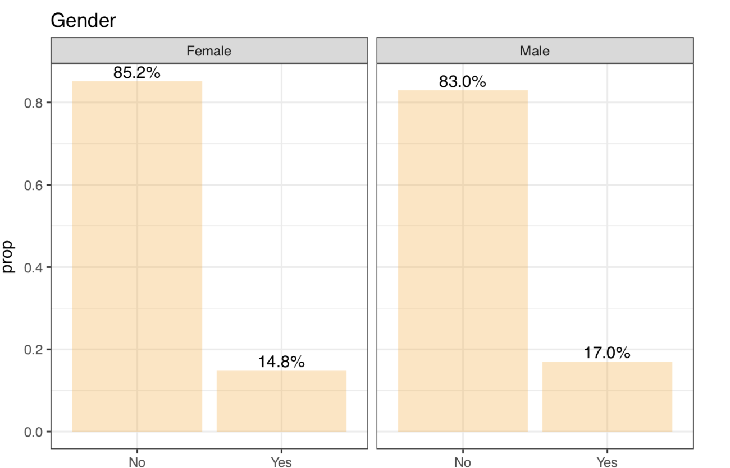
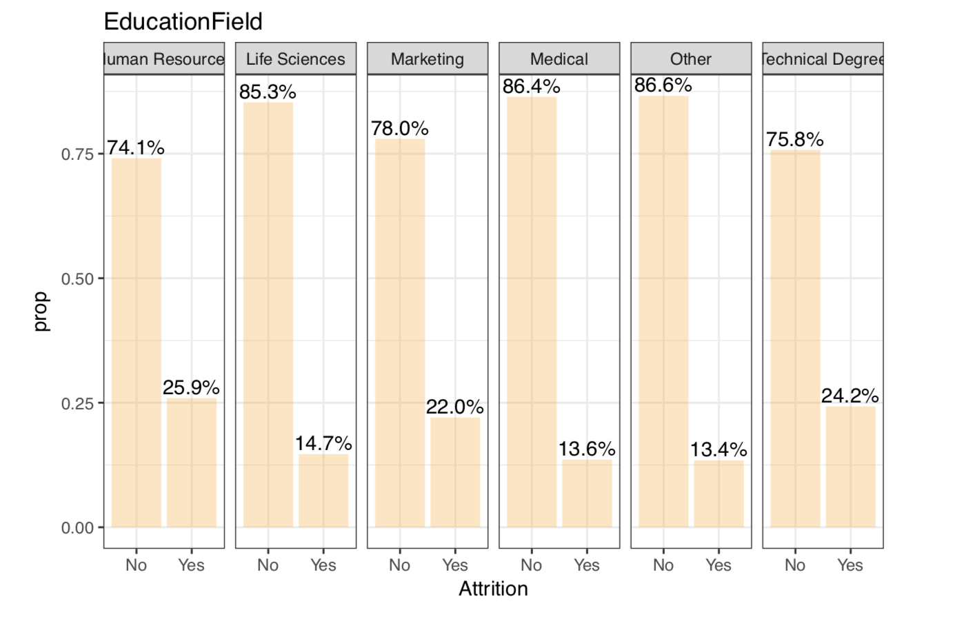
Exploratory Analysis – Business Travel, Department, Education Field, Gender
Notes:
Categorical & Objective Variable Analysis
Employees who travel frequently have a higher attrition rate.
We also examined other fields, such as gender, and we did not see a significant difference when examining the variable by itself.

Slide 9
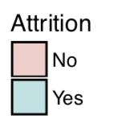
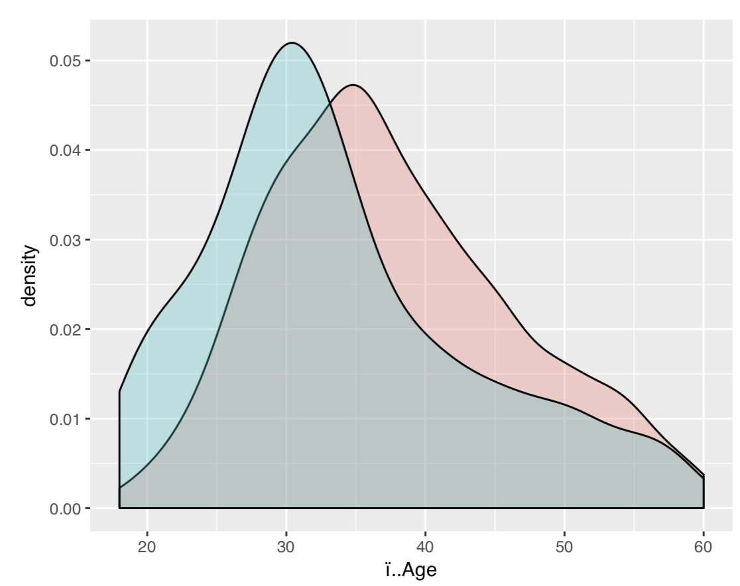
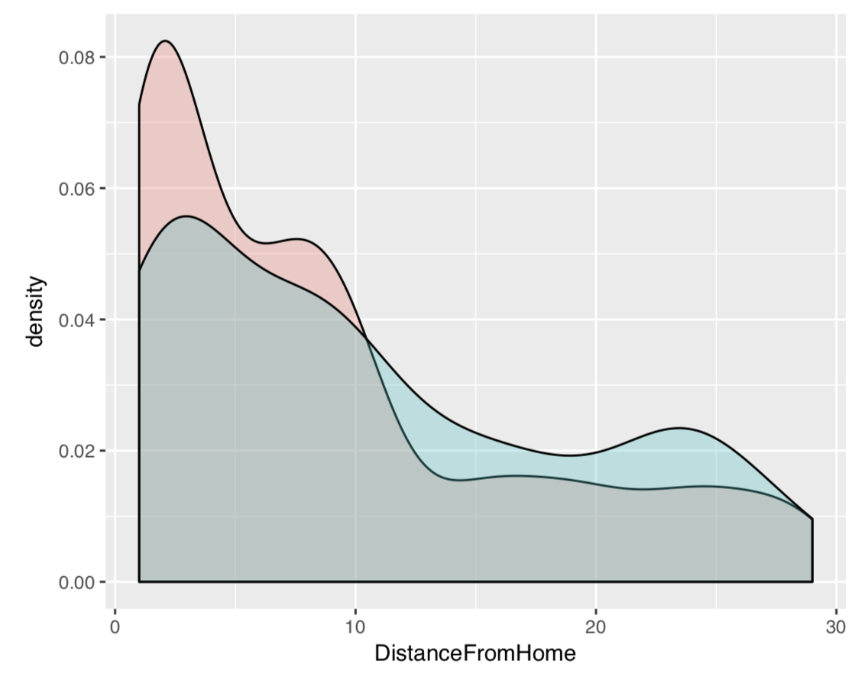
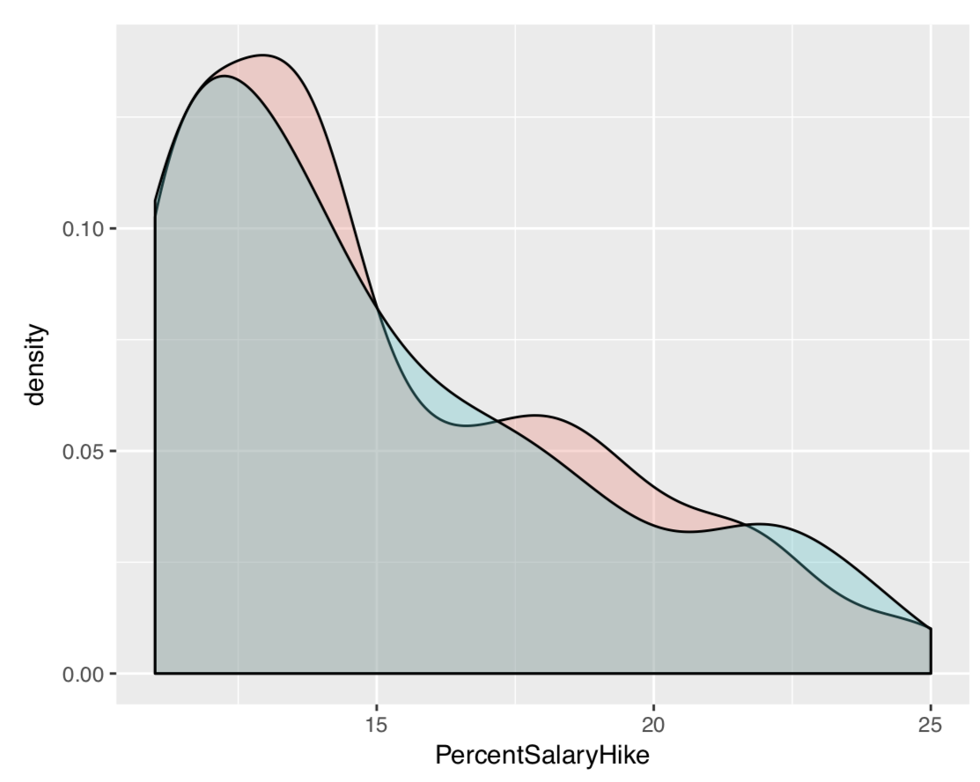
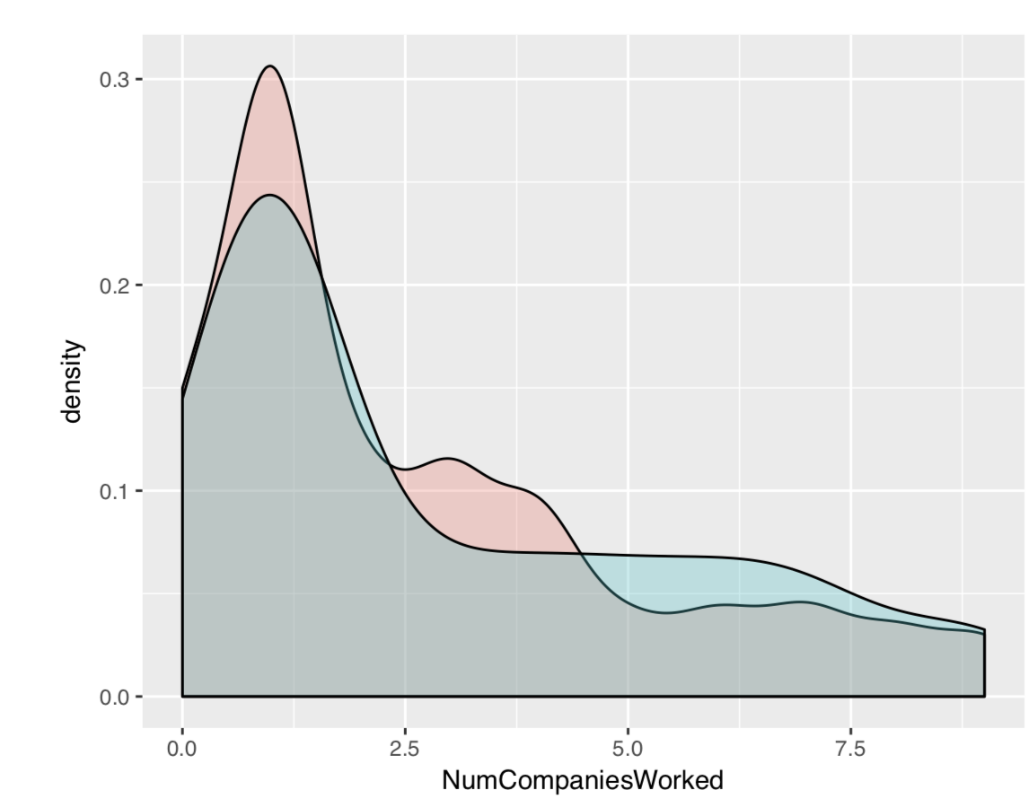
Exploratory Analysis – Age, Distance From Home, % Salary Hike, # of companies worked
Age 33
Notes:
People below the age of 33 have a higher probability of leaving the company

Slide 10
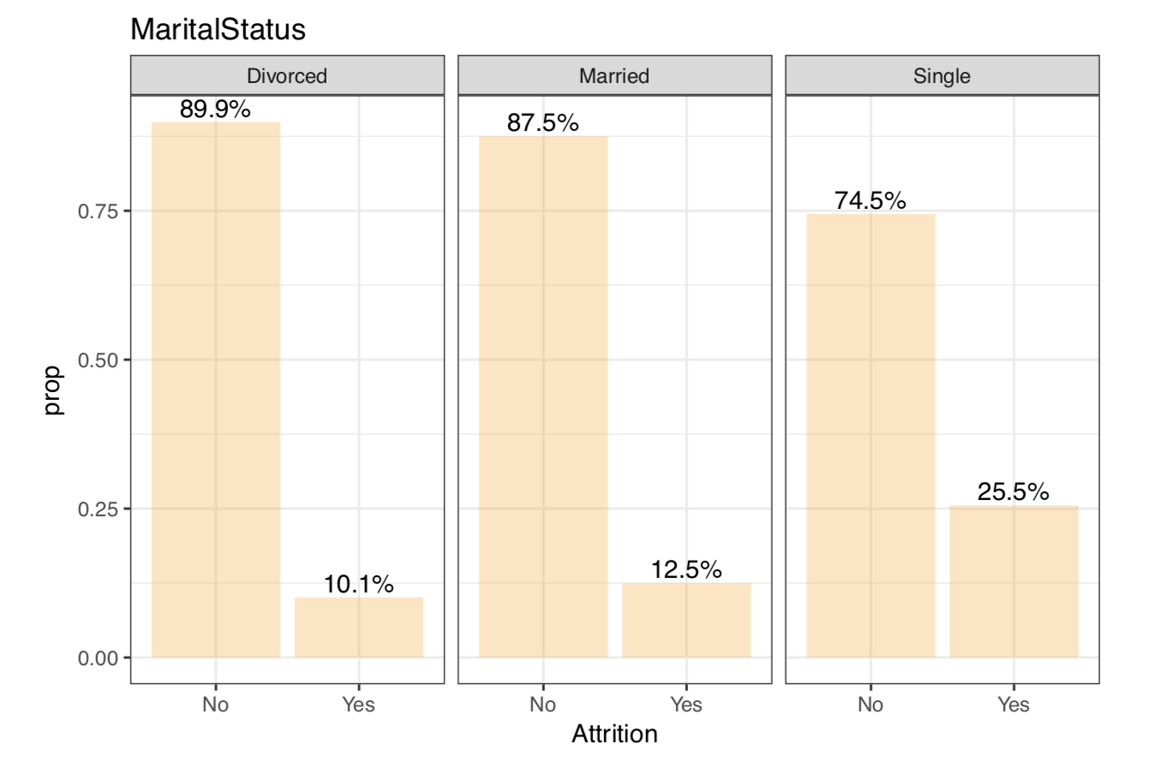
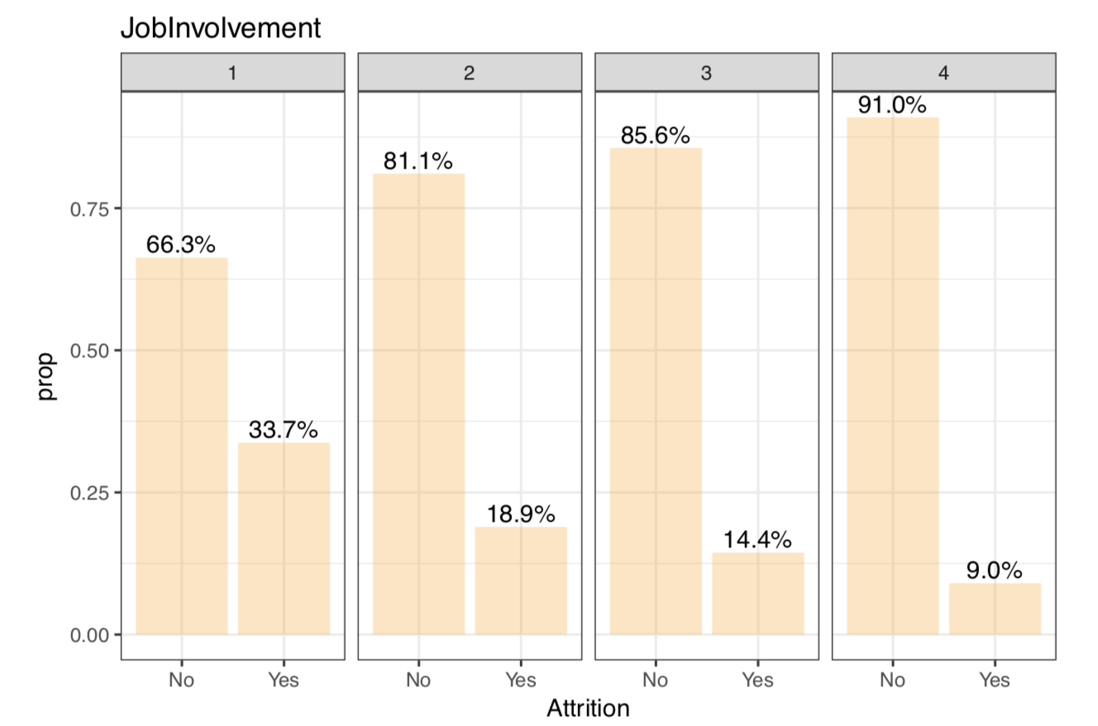
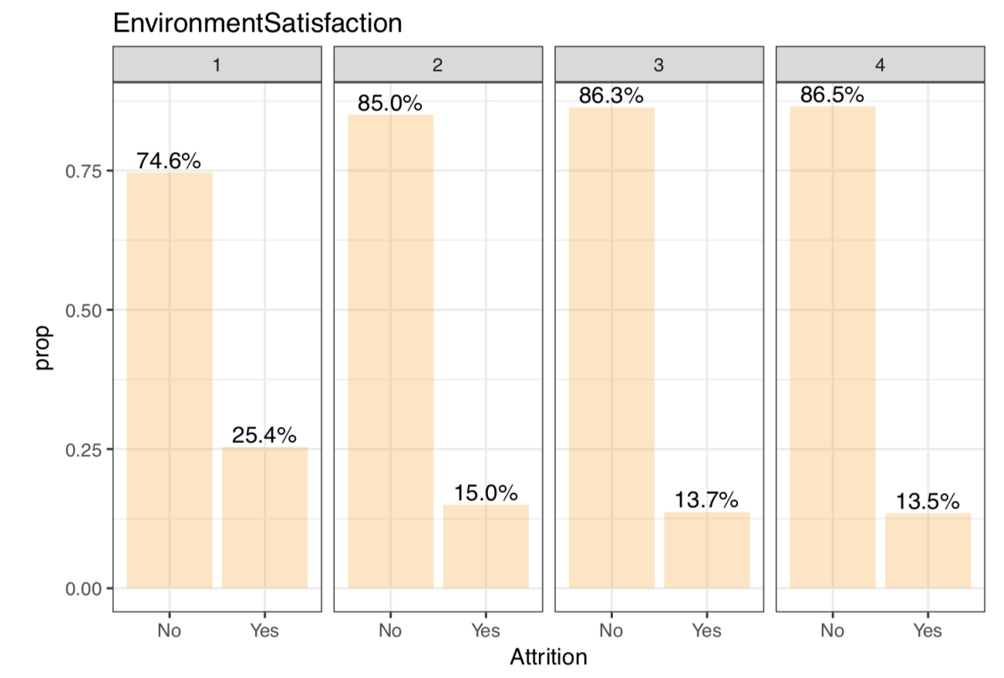
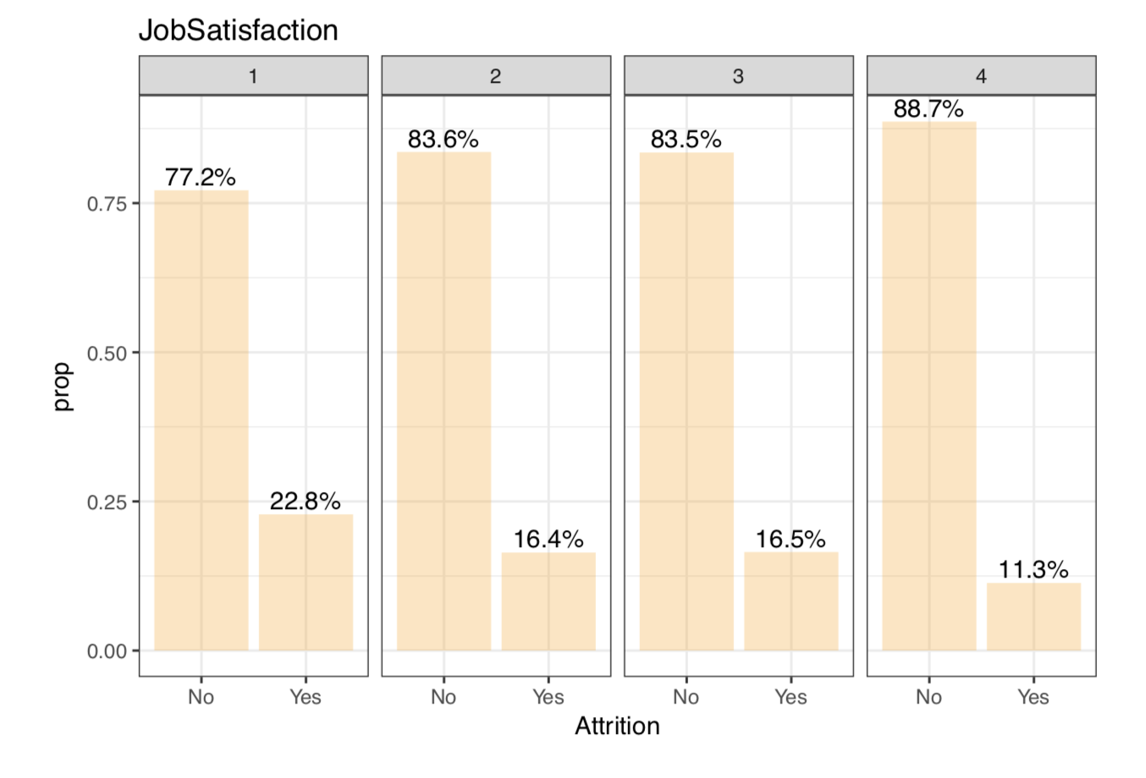
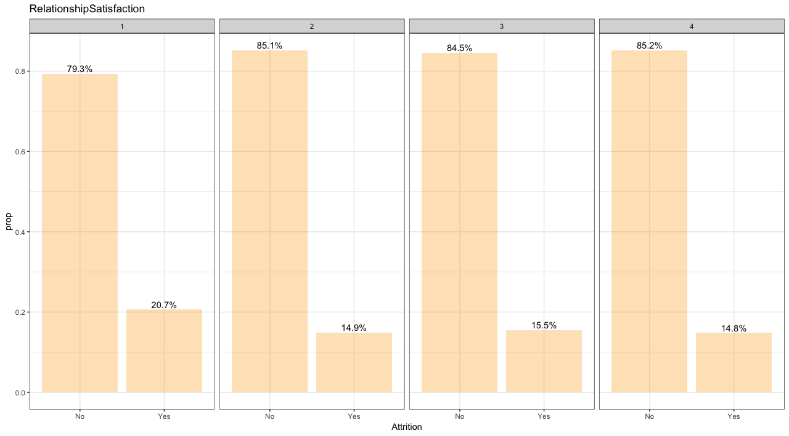
Exploratory Analysis – Job Involvement, Environment Sat., Job Sat., Relationship Sat
Notes:
Subjective Variable Analysis – the variables on this page are subjective and each are rate on a scale (1 = low, 4 = high)
For each of the four variables, employees with a rating of 1 (low) had a higher attrition rate.

Slide 11
Analysis and Findings – Model Overview
Logistic Regression
Boosting
Random Forest
Tree
K Nearest Neighbors
Naïve Bayes
Linear Discriminate Analysis

Slide 12
Analysis and Findings – Model Selection
Unbalanced Attrition Sample
84% No, 16 % Yes
Error Measurement
% of People who leave IF we predict they will leave
% of People who leave IF we predict they will stay
Notes:
Insert Histogram

Slide 13
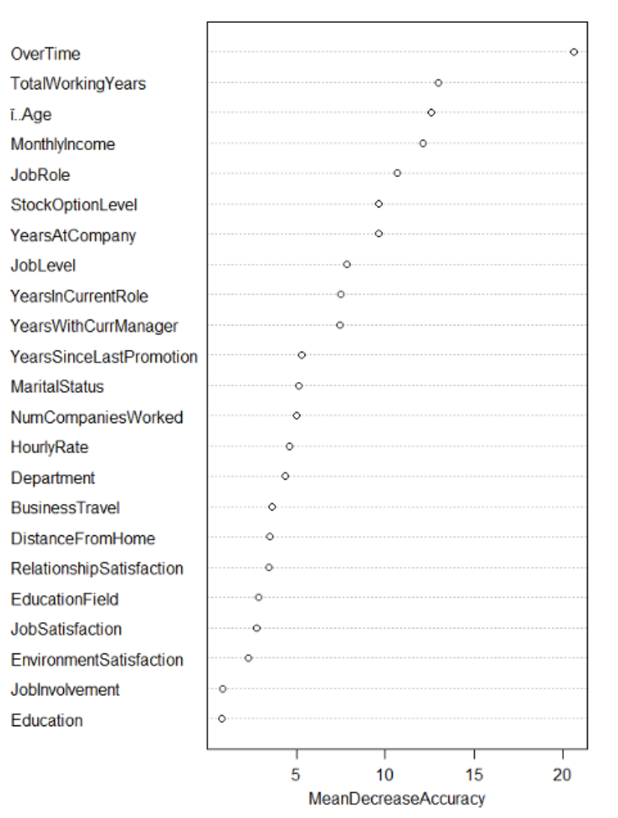
Analysis and Findings – Models: Tree, Boosting, and Random Forest
Tree
Size = 3, NO: p>0.65
criterion 1 = .41, criterion 2 = .11
Boosting
CV on lambda, d = 1 or 2
criterion 1 = .76, criterion 2 = .14
Random Forest
m =sqrt(p), ntree = 500
criterion 1 = .78, criterion 2 = .14

Slide 14
Analysis and Findings – Other Models Explored: knn, lda, nb
K Nearest Neighbors
24 predictors; k=5;No: p>0.6
criterion 1: 0.667; criterion 2: 0.141
Linear Discriminant Analysis
25 predictors; No: p>0.35
criterion 1: 0.821; criterion 2: 0.126
Naïve Bayes
30 predictors; No: p>0.1
criterion 1: 0.655; criterion 2: 0.136

Slide 15
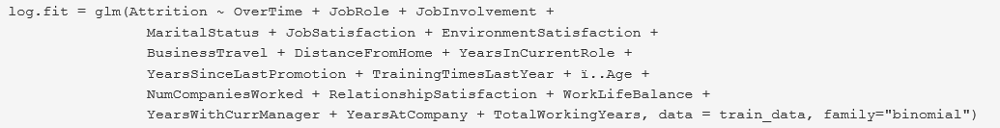
Analysis and Findings –
Best Model: Logistic Regression
stepwise selection: 18 variables left
 |  | Actual
 |  | NO | YES
Predicted | NO | 364 | 55
 | YES | 2 | 20

Slide 16
Model Summary (1-3 of 7)
Model | Model Formula (Shows Excluded Variables) |  | Accuracy | % of People - LEAVE If Prediction - WILL LEAVE | % of People - LEAVE If Prediction - WILL STAY
Logistic Regression | ‘Attrition~. - Daily Rate - Department - Education - Education Field - Gender - Hourly Rate | - Job Level - Monthly Income - Monthly Rate - Percent Salary Hike - Performance Rating - Stock Option Level | 0.871 | 0.909 | 0.131
Linear Discriminant Analysis | ‘Attrition~. - Monthly Income - Performance Rating | - Education - Department - Gender‘ | 0.871 | 0.821 | 0.126
Boosting | ‘Attrition~. - Performance Rating | - Gender - Department‘ | 0.859 | 0.760 | 0.135

Slide 17
Model Summary (4-7 of 7)
Model | Model Formula (Shows Excluded Variables) |  | Accuracy | % of People - LEAVE If Prediction - WILL LEAVE | % of People - LEAVE If Prediction - WILL STAY
Random Forest | ‘Attrition~. - Monthly Rate - Performance Rating - Training Times Last Year | - Gender - Work Life Balance - Percent Salary Hike - Daily Rate‘ | 0.871 | 0.679 | 0.136
knn | ‘Attrition ~ . - Job Level - Gender - Daily Rate | - Department - Percent Salary Hike‘ | 0.844 | 0.667 | 0.141
Naïve Bayes | ‘Attrition~.- |  | 0.850 | 0.655 | 0.136
Tree | ‘Attrition~.- |  | 0.841 | 0.414 | 0.110

Slide 18
Questions?

